Slide 1
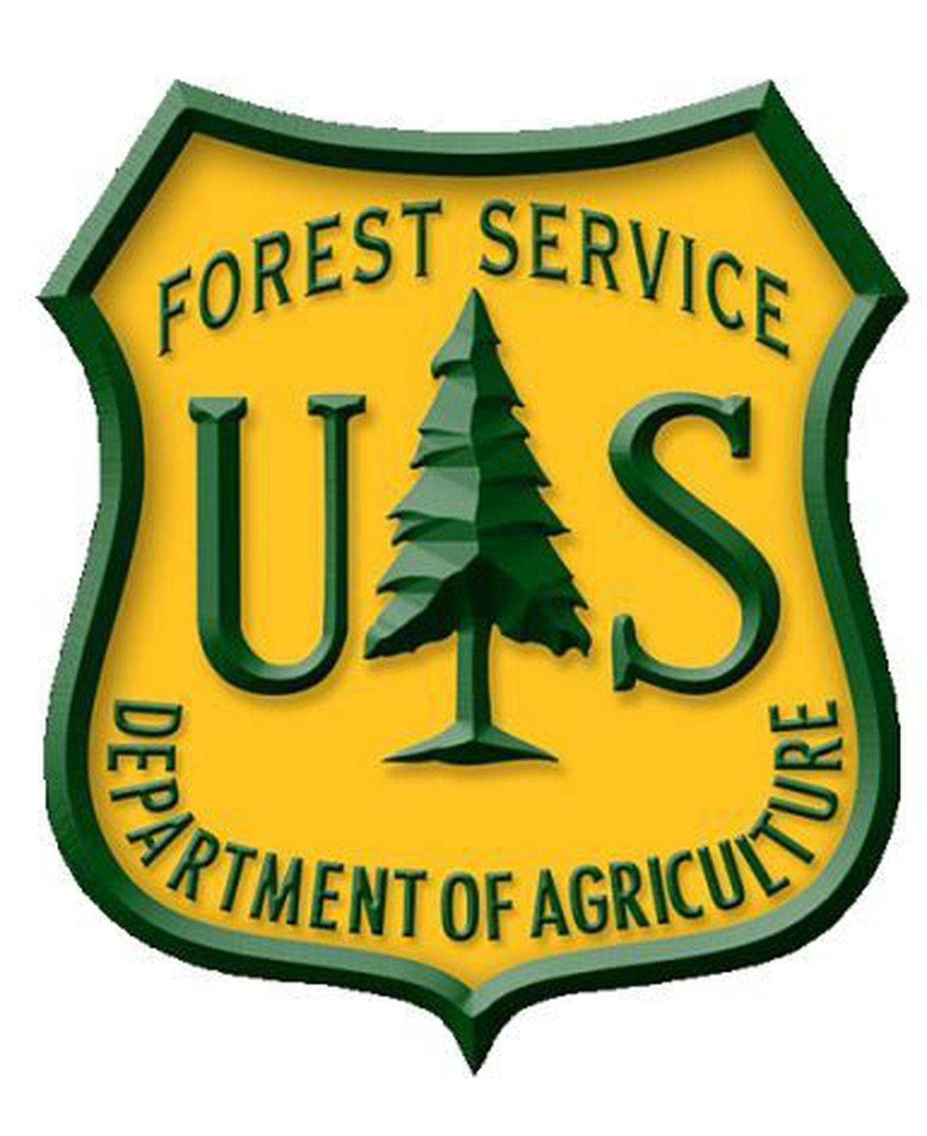

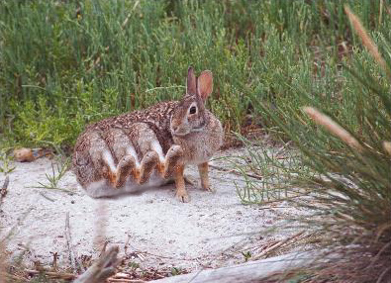
Lepus Octopedis: Suitability Analysis
L. Octopedis, 2021
Ian Forsyth
Sierra Vista Ranger District
GEOG 417 – Lab 12

Slide 2

Lepus Octopedis
A genetically engineered, eight-legged rabbit developed at Columbia.
According the research conducted there, this rabbit has shown a positive impact on the environment which it occupies. It’s eight legs provide additional soil stimulation, which in turn increases permeability and overall condition.
Improvements to the range conditions, wildlife habitat, and reduction of soil erosion are all reported findings. This is potentially a positive economic opportunity for this range as well.
The current allotments are inhabited by mammals similar in appearance and disposition that may expedite this new creatures familiarity in a wild setting.

Slide 3
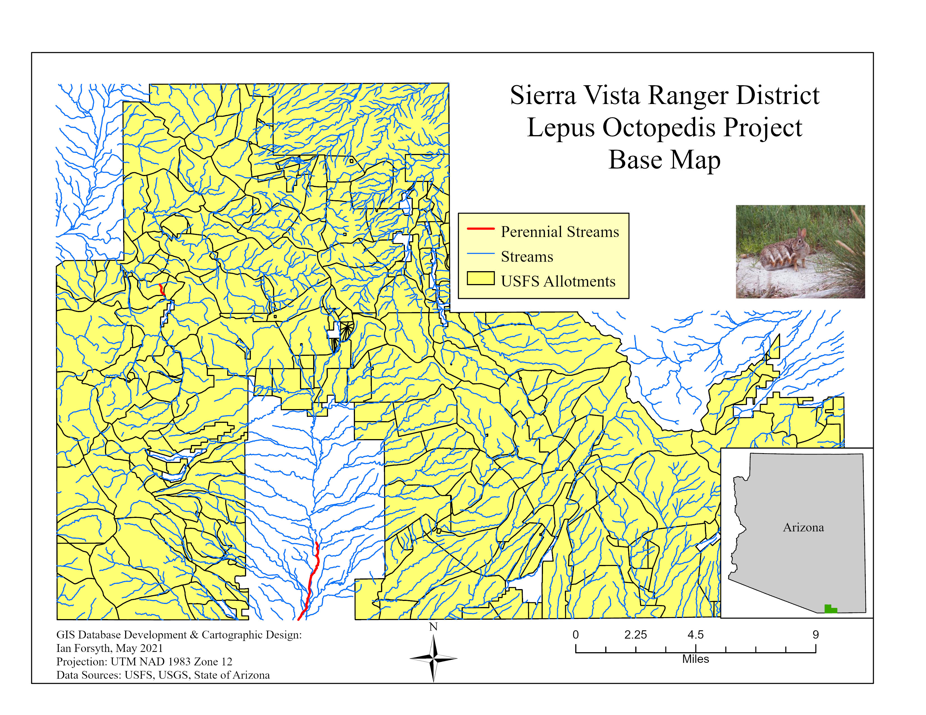
Areas in yellow are the public land allotments provided by the US Forest Service for the relocation of this species.
This map demonstrates all possible areas for the rabbit to occupy.
This is not an indication that we can set these creatures down anywhere.
Our goal was finding an area where the rabbits can not only survive, but thrive.
The rabbit ranch must be optimal in vegetation, water sources, and largely free of predators.

Slide 4
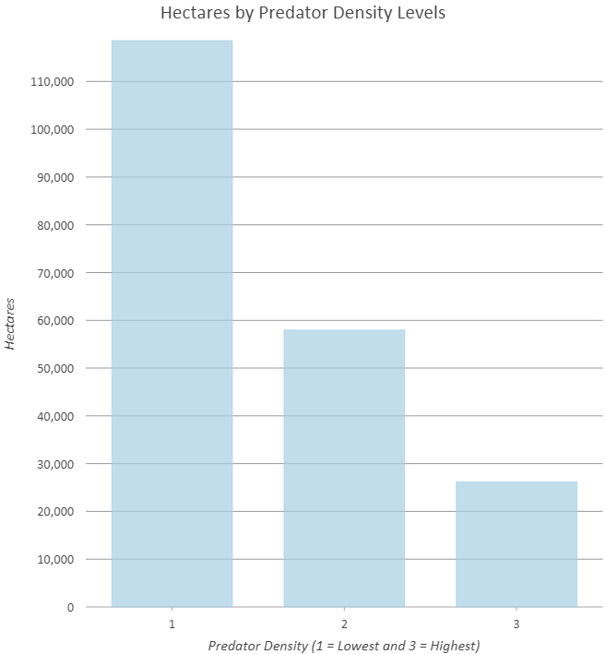
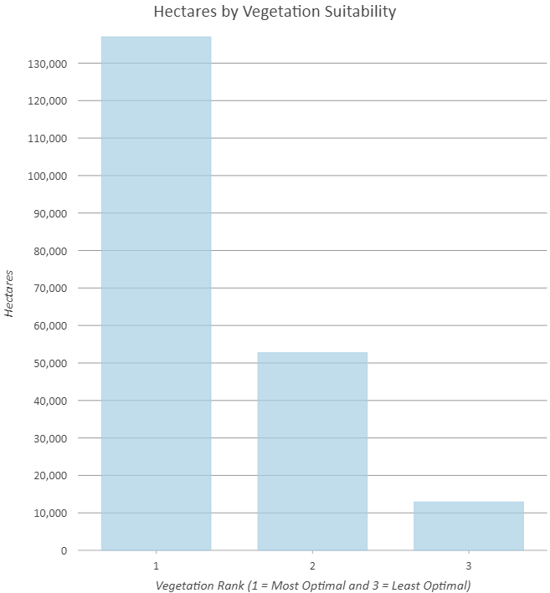
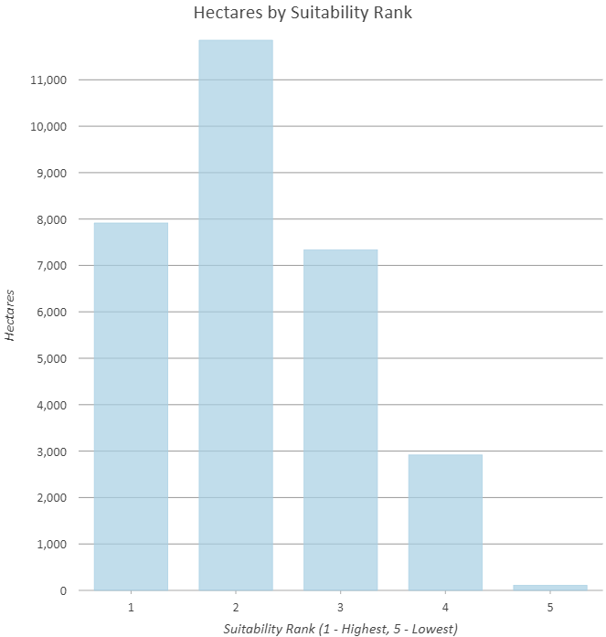
The chart above (left) is a graphical model of suitable land measured in hectares. These areas of varying suitability are calculated with the data (center and right) that show the areas of predator density and optimal vegetation, also measured in hectares.
As we can see, there appear to be large areas with low predator density and optimal vegetation, however these calculations have not factored in our available allotments of land, or perennial water sources. These key components will be addressed later.

Slide 5
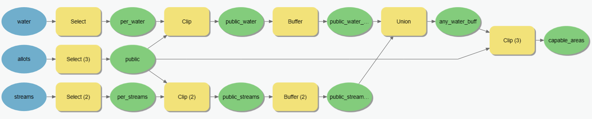
Capability Model (SQL)
This model, shown in the database’s Structured Query Language (SQL) is what was used to create the maps that follow. It is how we communicate with the program to follow the constraints provided, and narrow down our capable areas from the allotments that are available.
While it may look like several polygons stitched together, it is much more meaningful when shown the results.

Slide 6
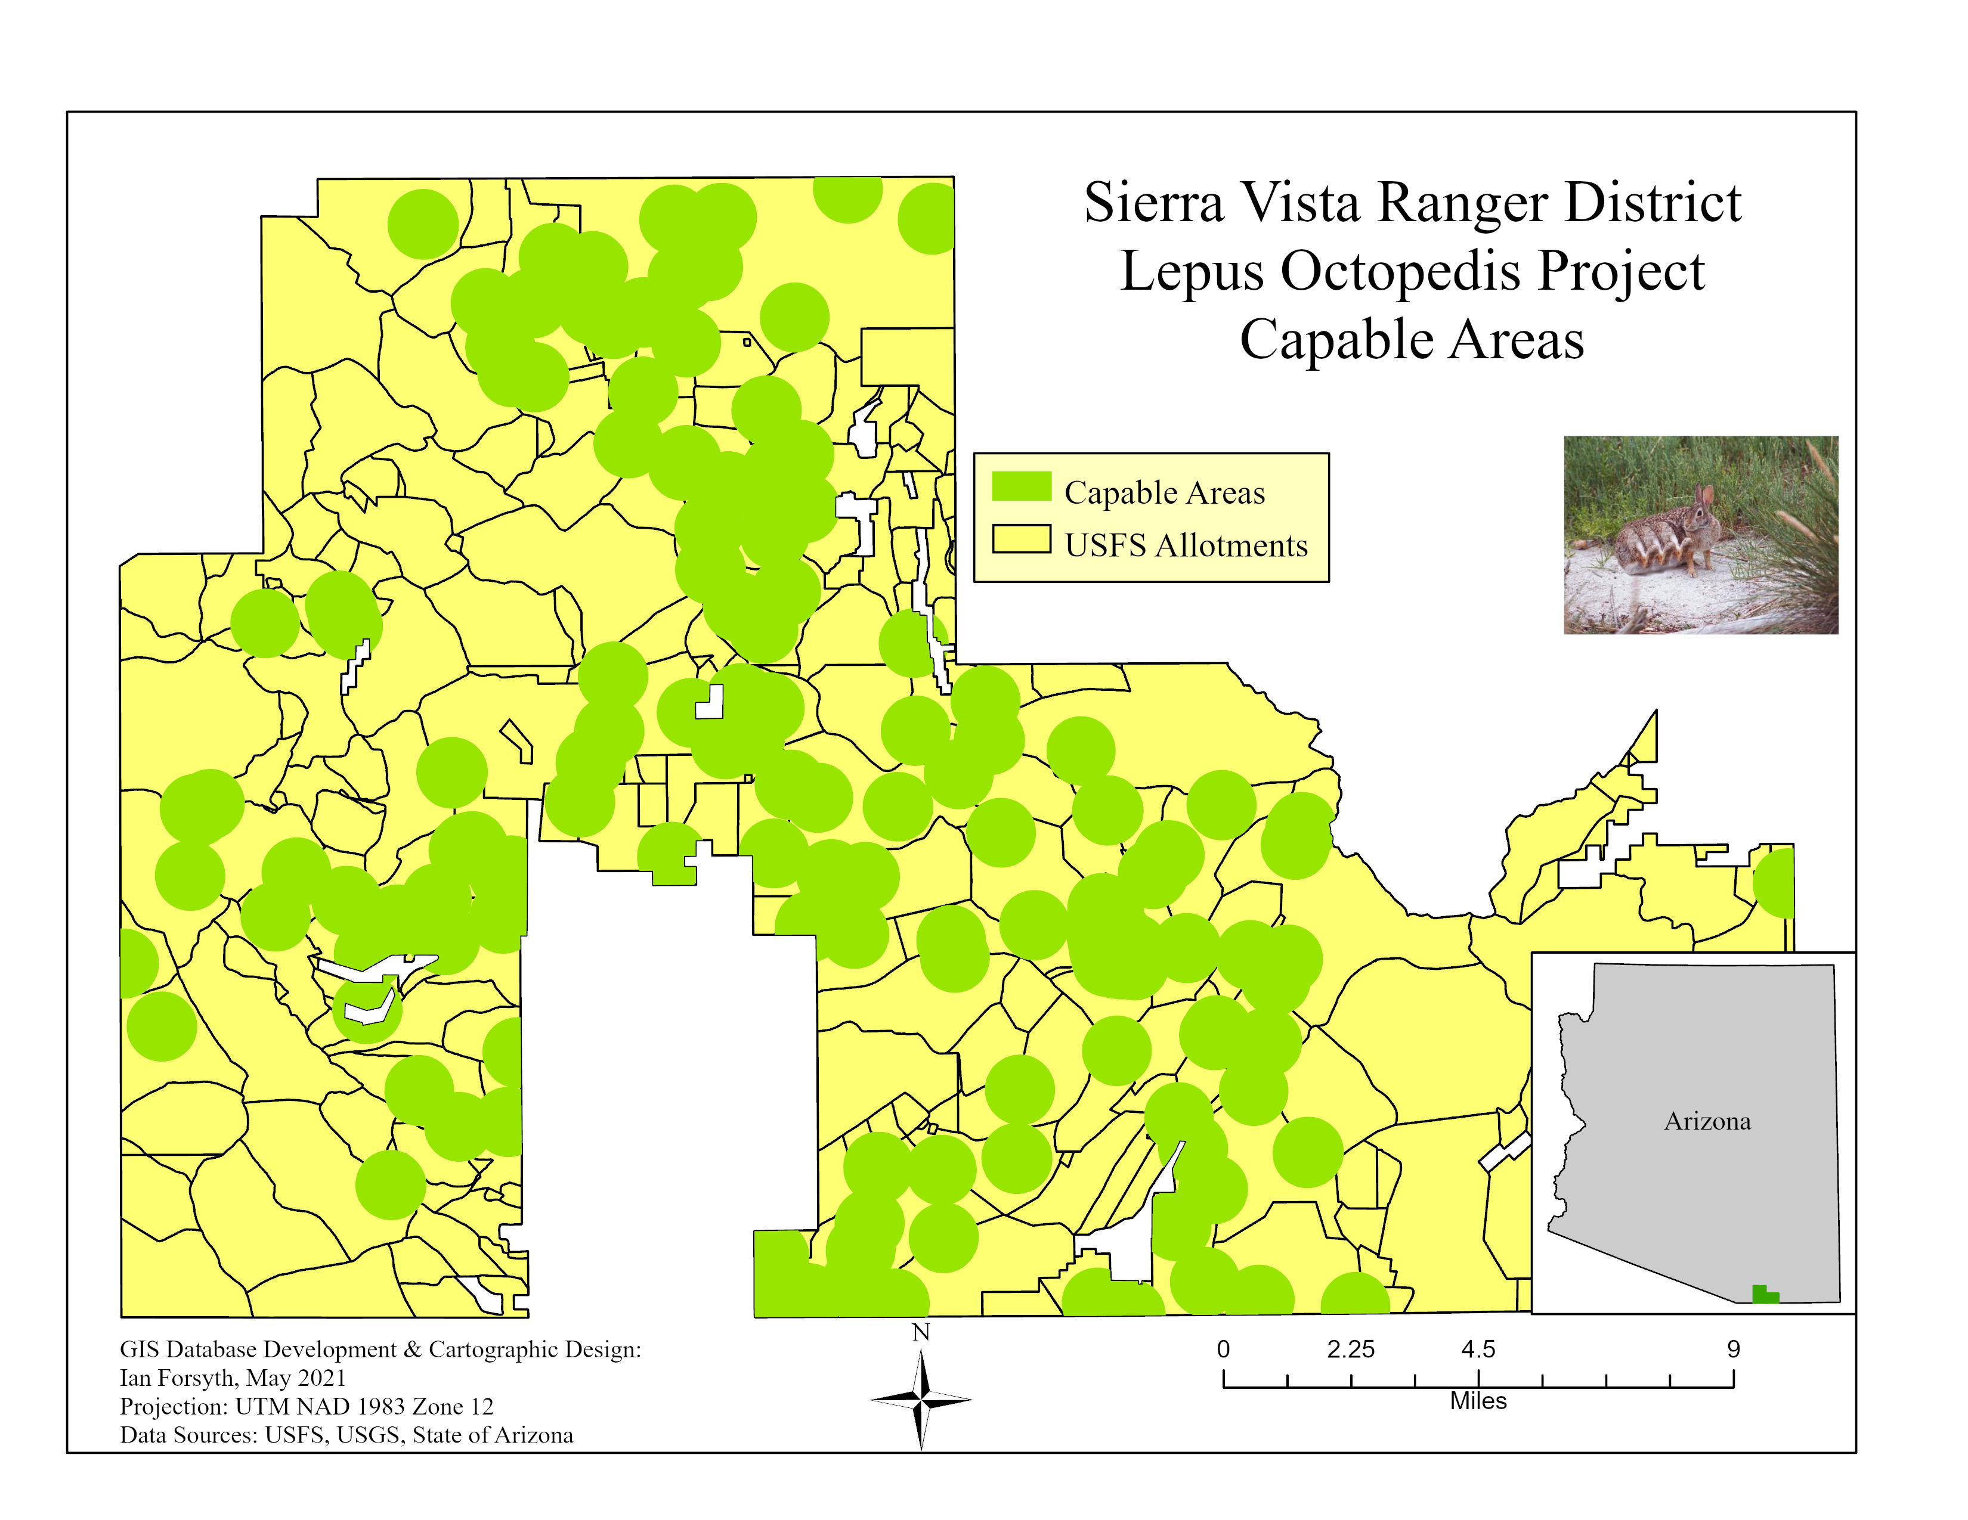
Our work with SQL has used our parameters to narrow the options into a more manageable working map.
This is the direct result of our Model Builder tool, which was shown previously.
The green circles indicate the areas which meet our constraints, but overlap not only each other, but allotments as well.
This is a representation of where a good place to start narrowing down available allotments is.

Slide 7
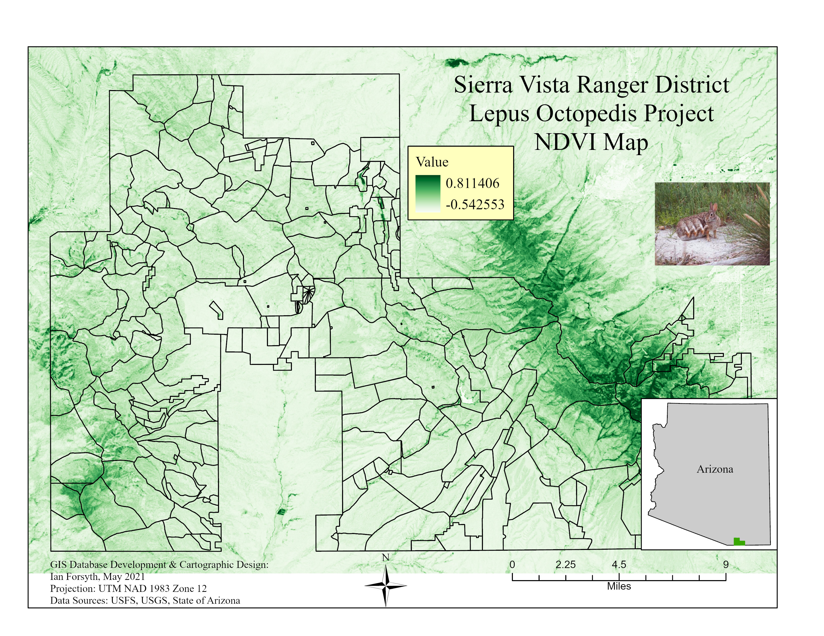
This map displays the Normalized Difference Vegetation Index (NDVI) overlaid on our base map.
This type of analysis is important when establishing the optimal vegetation areas for this species.
Our darker areas indicate dense tree coverage, and normal vegetation levels are present in the lighter areas.
It should be noted that the period of observation is one of the driest parts of the year, and the grasslands reflect as such.
These lighter green sections coincide with our capable areas, and are also the flora that L. Octopedis prefers.

Slide 8
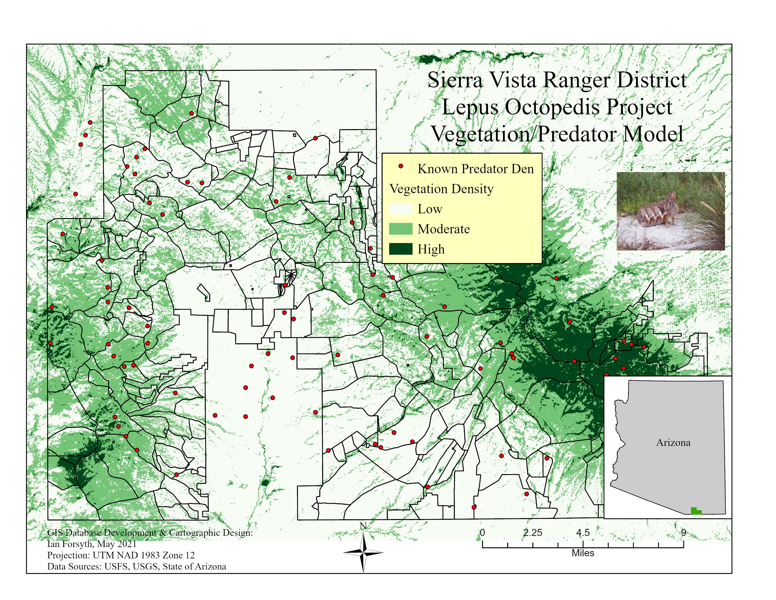
Observed known predator locations (dens, nests, etc.) are indicated by a red point.
Our NDVI map made it possible to determine which areas of vegetation density are of the correct plants/shrubbery.
With the information on predator locations, we can narrow the search for an optimal allotment.
Visually, this can be hard to understand. We can see the dens, but their spacing can make things difficult.

Slide 9
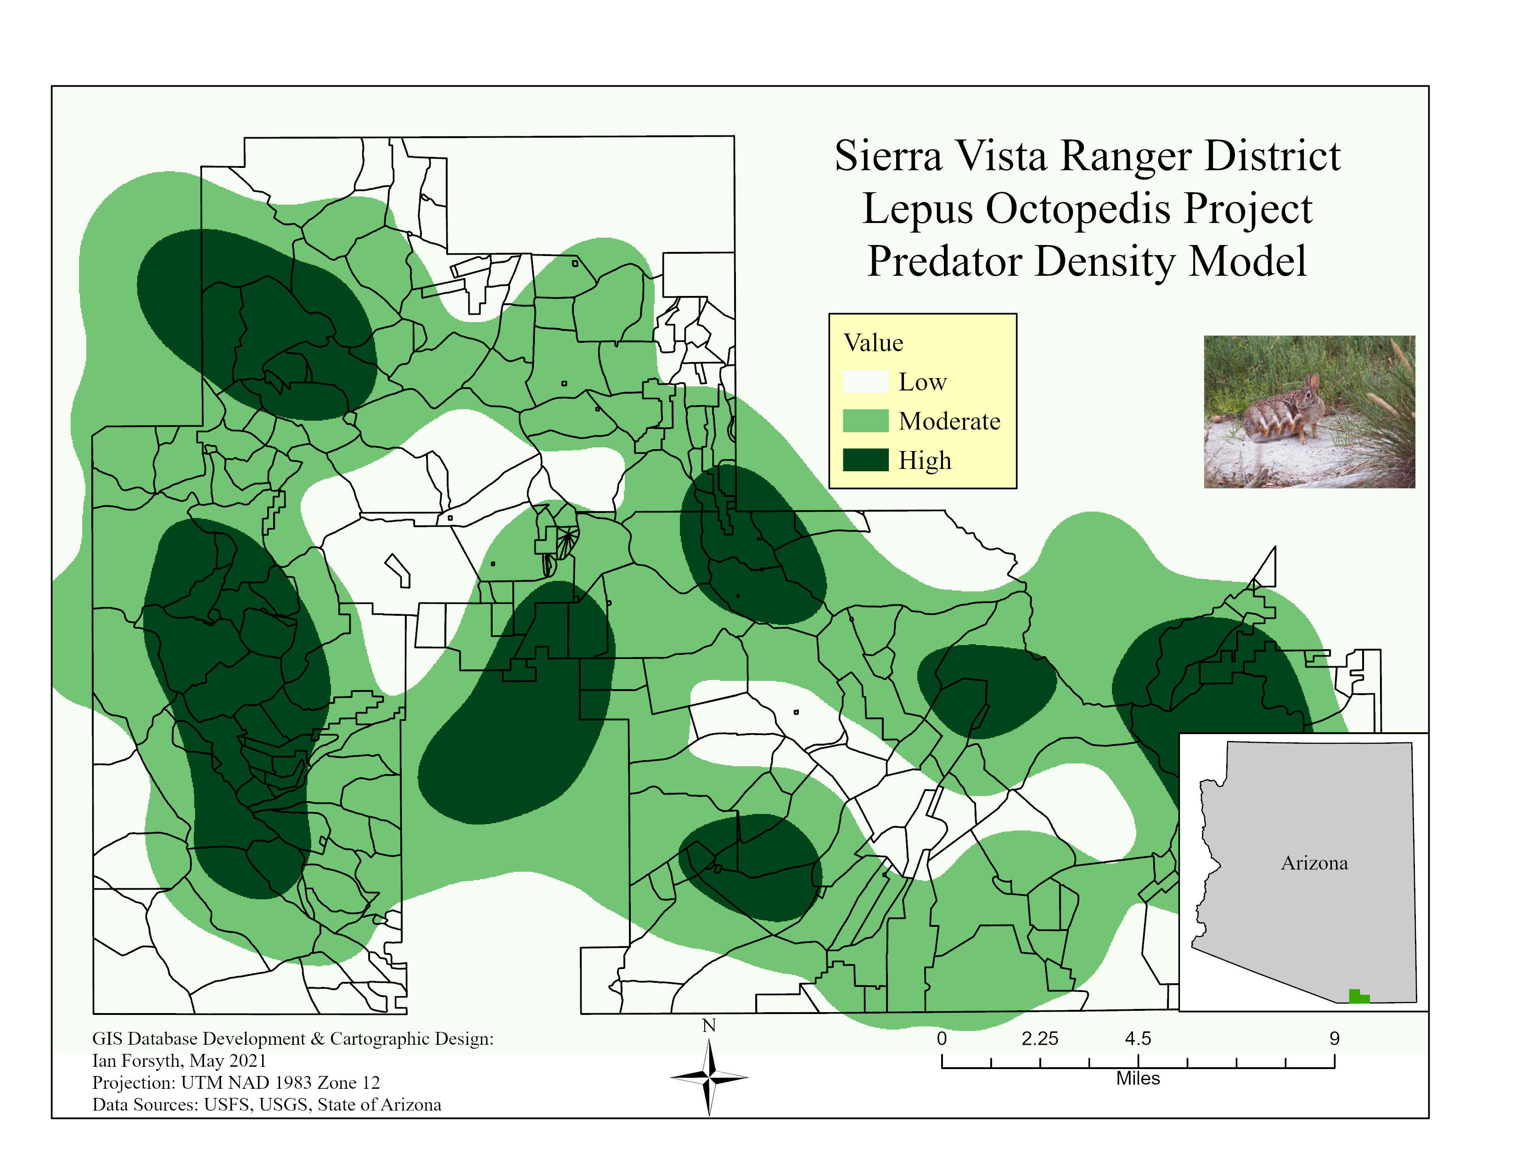
Further application of our predator specific constraints reveals areas of high and low density.
Areas with high predator density are not optimal for the introduction of L. Octopedis.
Known predator locations must be at least 5km away from allotments to be considered suitable.
Data is used in conjunction with the NDVI map to further narrow the options for allotments.

Slide 10
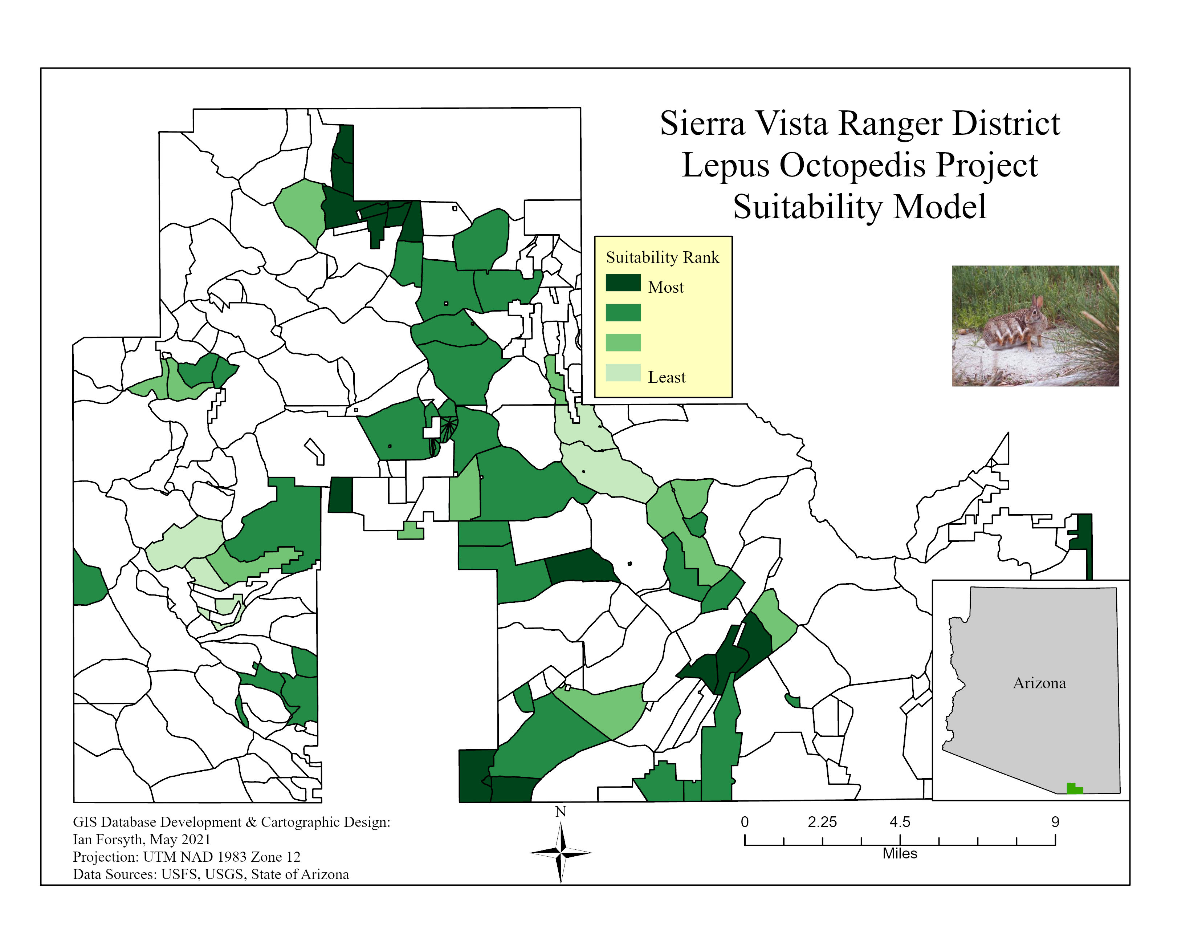
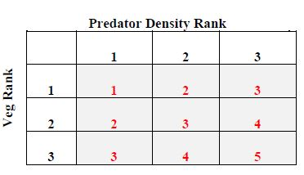
The combination of all constraints applied through the previous maps gives us the final model.
The matrix below was created by assigning a rank structure to both predator density levels and appropriate vegetation levels.
This was then applied into our model to create a suitability ranking. When combined with our map, the suitability of each allotment is then assigned a rank as well.

Slide 11
The identification of these areas deemed most suitable are recommended for the placement of L. Octopedis
These areas circled in red are highly suitable.
They are far from predators, close to water, and have the proper grass for the rabbit’s diet.
The model fails to consider that some allotments are large enough to accommodate the ranch, but are excluded because their border is too close to a predator. The model simply writes off the entire allotment.

